Slide 1
CPSC 440
§3.1 Introduction
Chapter 4: The Processor
(part 3)*
* This ppt is provided by the publisher of the textbook
Notes:
Morgan Kaufmann Publishers
Chapter 3 — Arithmetic for Computers

Slide 2
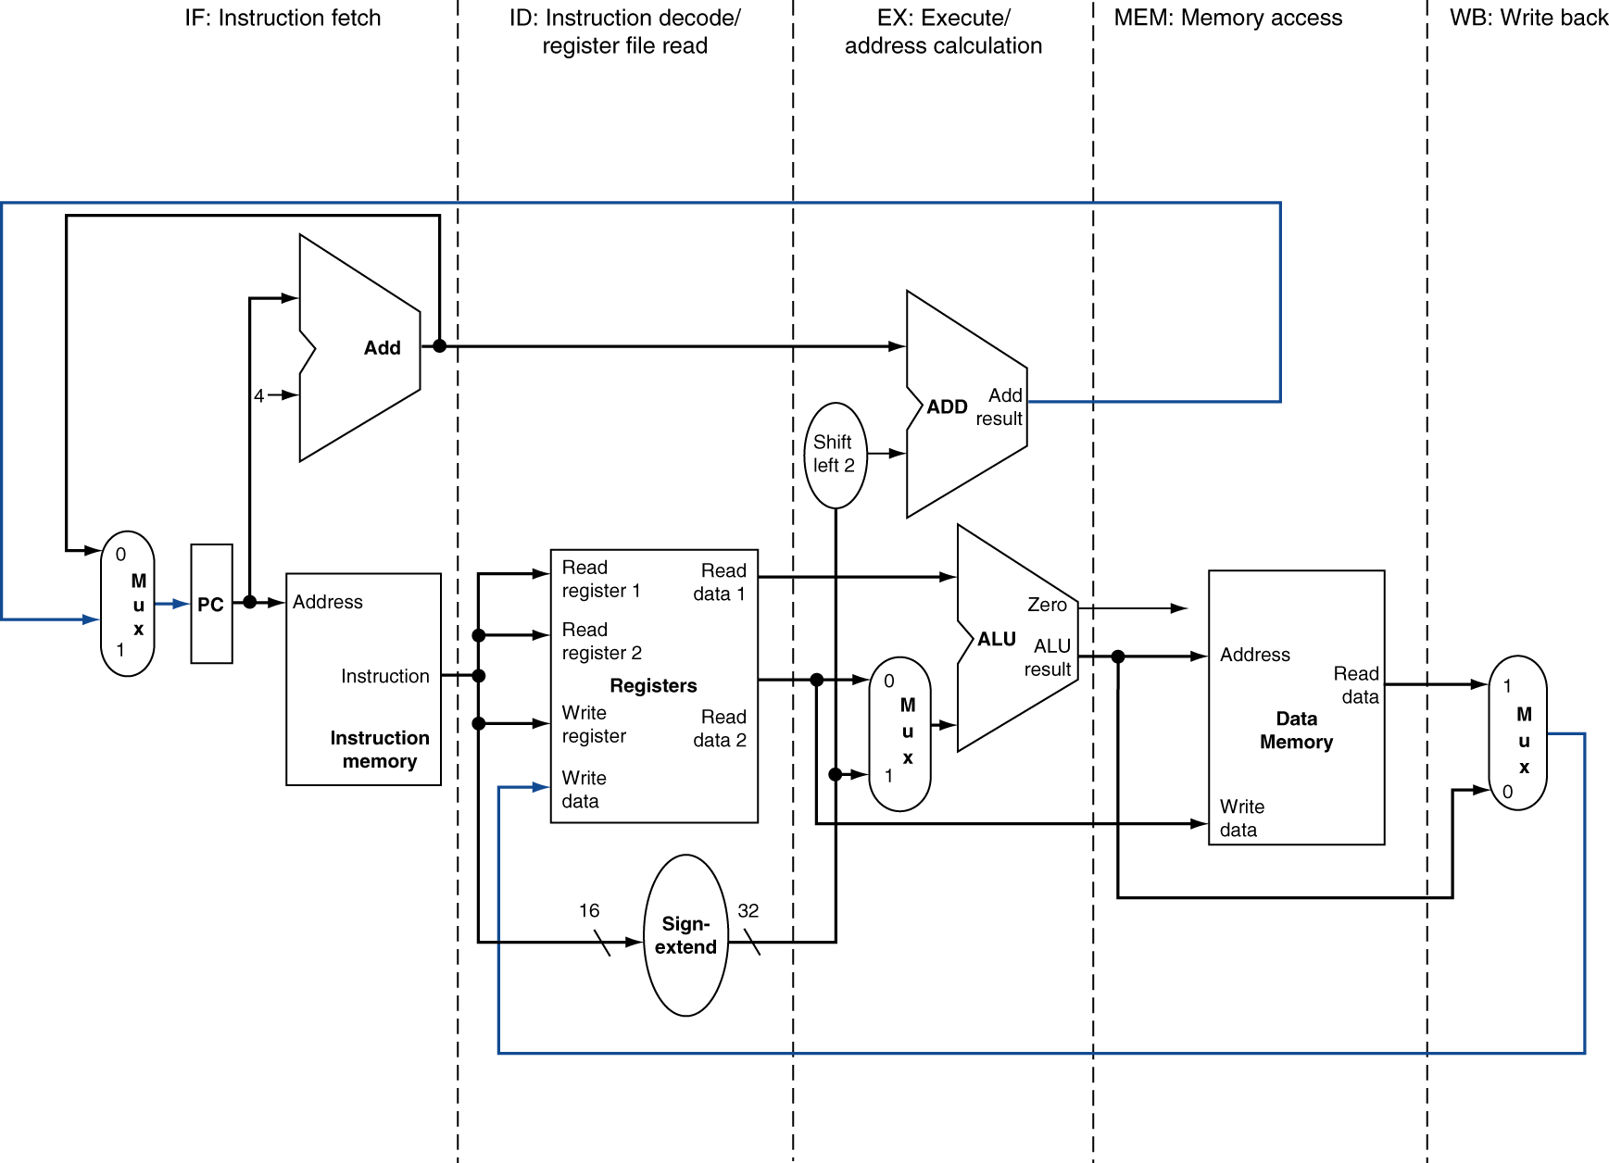
MIPS Pipelined Datapath
§4.6 Pipelined Datapath and Control
MEM
Right-to-left flow leads to hazards
WB
Chapter 4 — The Processor — <number>
Notes:
Morgan Kaufmann Publishers
Chapter 4 — The Processor

Slide 3
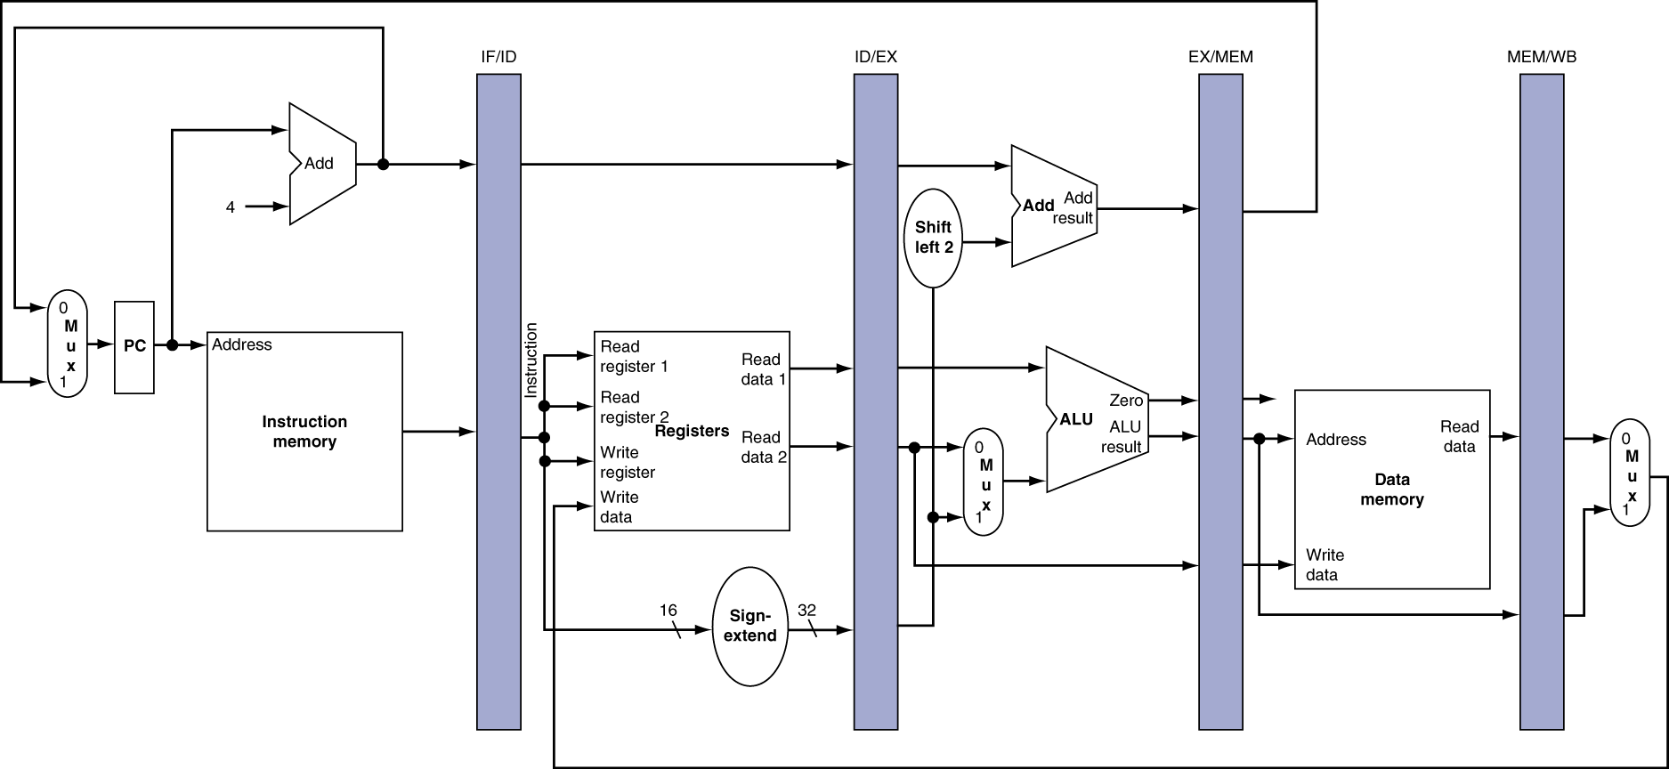
Pipeline registers
Need registers between stages
  To hold information produced in previous cycle
Chapter 4 — The Processor — <number>
Notes:
Morgan Kaufmann Publishers
Chapter 4 — The Processor

Slide 4
Pipeline Operation
Cycle-by-cycle flow of instructions through the pipelined datapath
  “Single-clock-cycle” pipeline diagram
    Shows pipeline usage in a single cycle
    Highlight resources used
  c.f. “multi-clock-cycle” diagram
    Graph of operation over time
We’ll look at “single-clock-cycle” diagrams for load & store
Chapter 4 — The Processor — <number>
Notes:
Morgan Kaufmann Publishers
Chapter 4 — The Processor

Slide 5
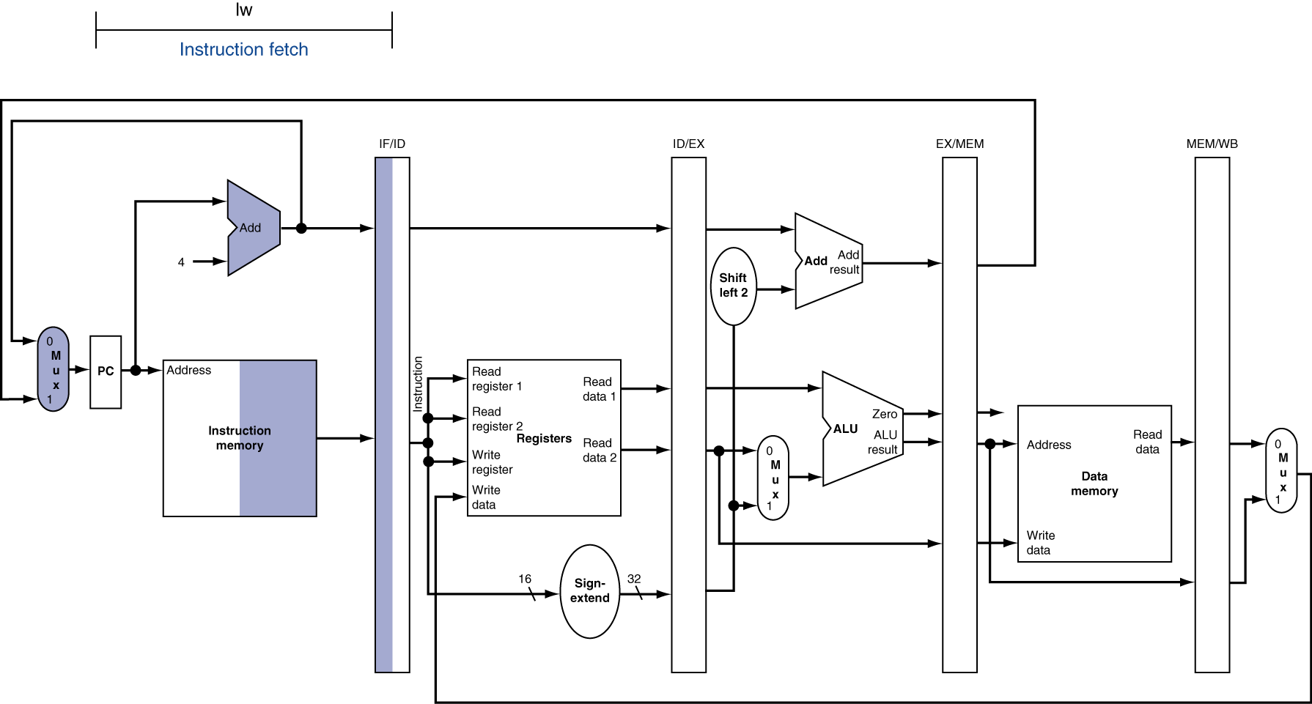
IF for Load, Store, …
Chapter 4 — The Processor — <number>
Notes:
Morgan Kaufmann Publishers
Chapter 4 — The Processor

Slide 6
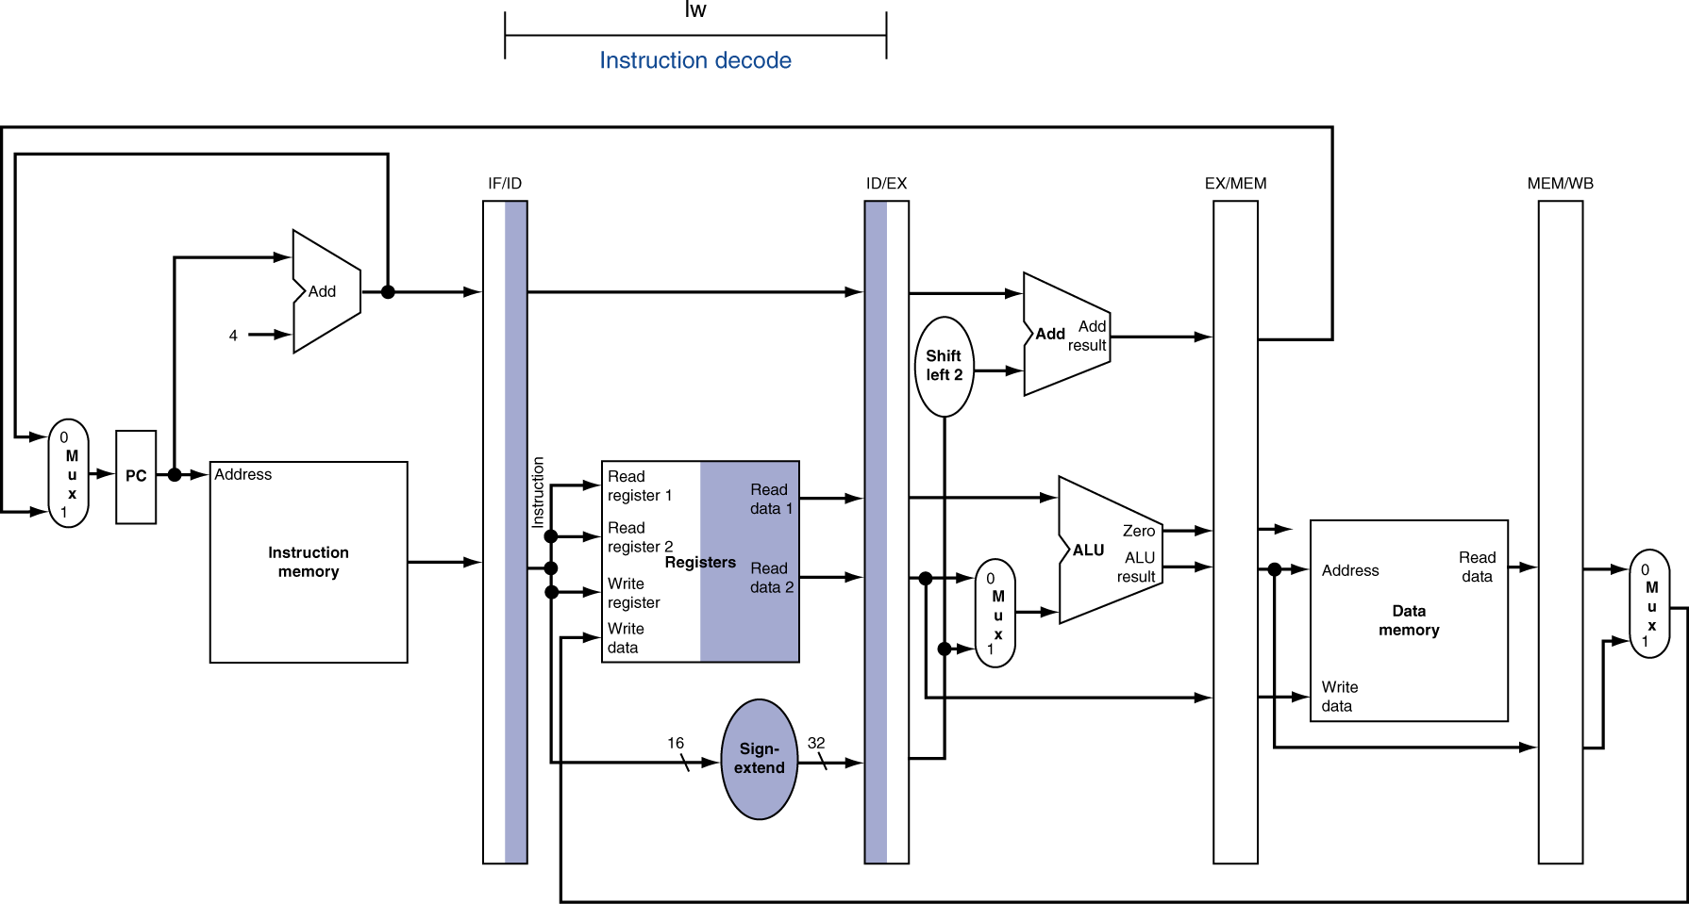
ID for Load, Store, …
Chapter 4 — The Processor — <number>
Notes:
Morgan Kaufmann Publishers
Chapter 4 — The Processor

Slide 7
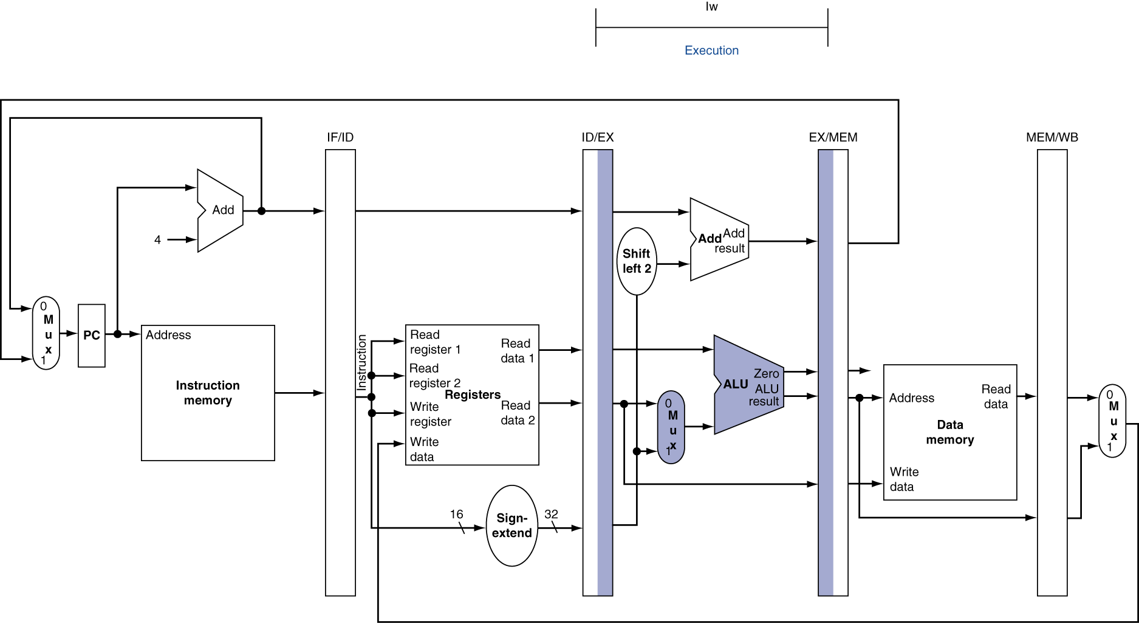
EX for Load
Chapter 4 — The Processor — <number>
Notes:
Morgan Kaufmann Publishers
Chapter 4 — The Processor

Slide 8
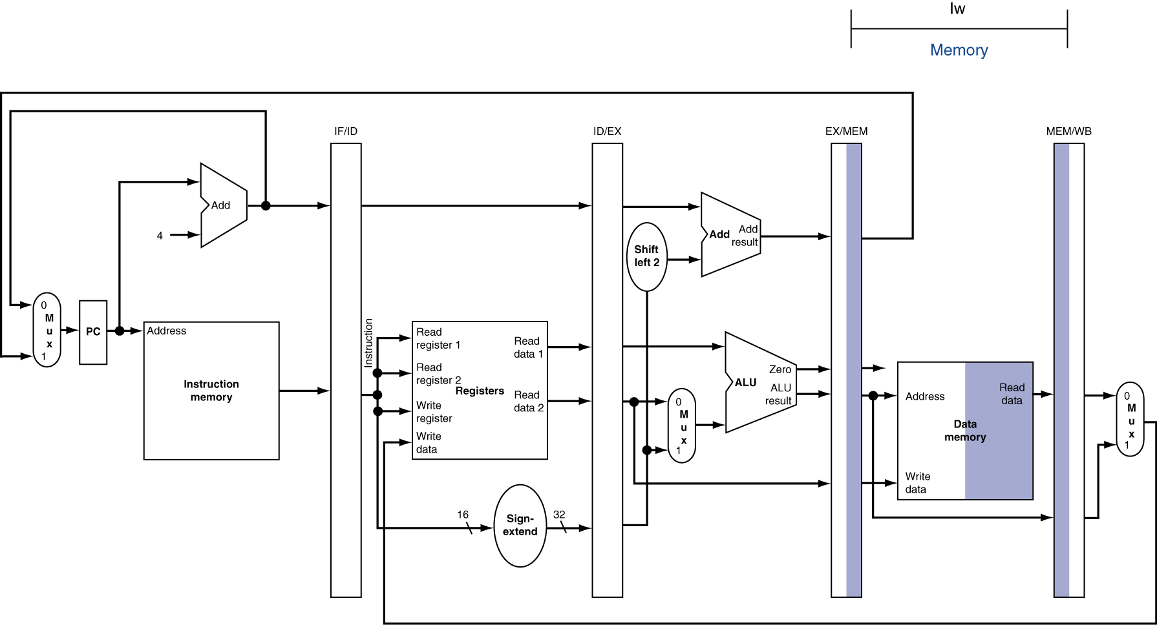
MEM for Load
Chapter 4 — The Processor — <number>
Notes:
Morgan Kaufmann Publishers
Chapter 4 — The Processor

Slide 9
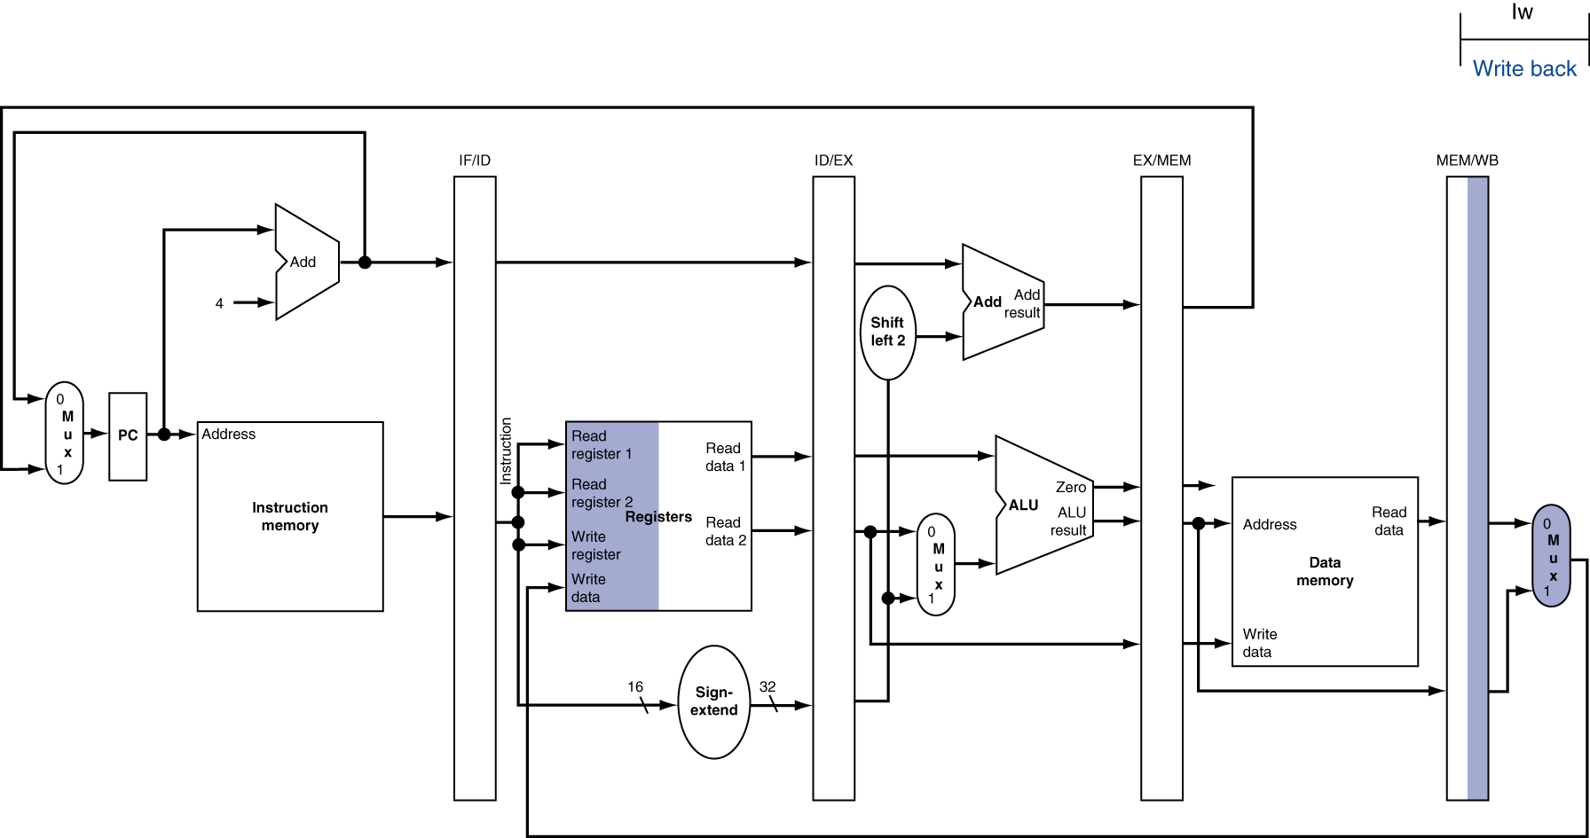
WB for Load
Wrong
register
number
Chapter 4 — The Processor — <number>
Notes:
Morgan Kaufmann Publishers
Chapter 4 — The Processor

Slide 10
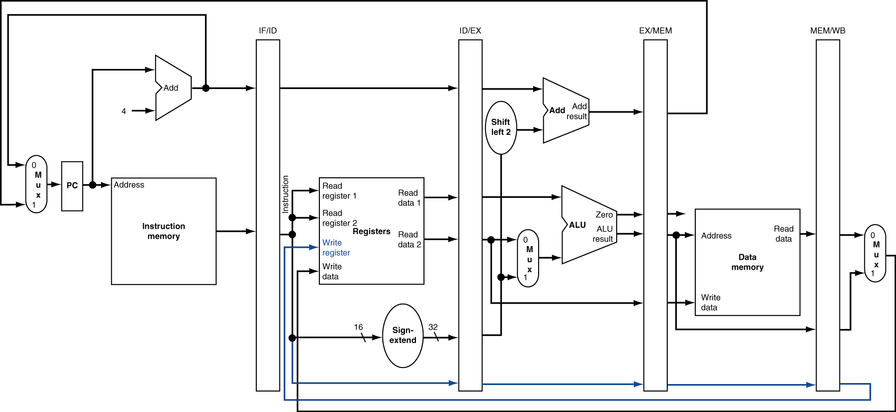
Corrected Datapath for Load
Chapter 4 — The Processor — <number>
Notes:
Morgan Kaufmann Publishers
Chapter 4 — The Processor

Slide 11

EX for Store
Chapter 4 — The Processor — <number>
Notes:
Morgan Kaufmann Publishers
Chapter 4 — The Processor

Slide 12
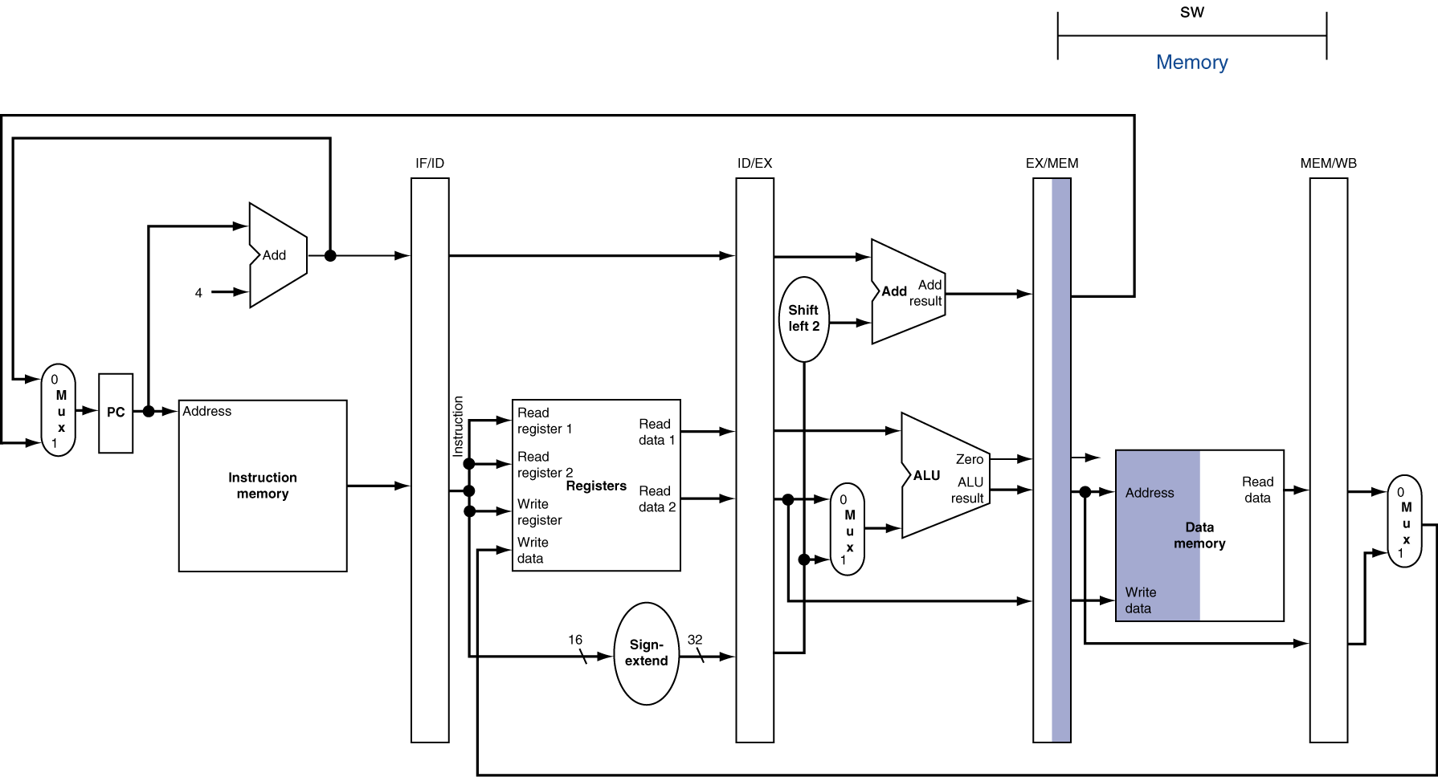
MEM for Store
Chapter 4 — The Processor — <number>
Notes:
Morgan Kaufmann Publishers
Chapter 4 — The Processor

Slide 13
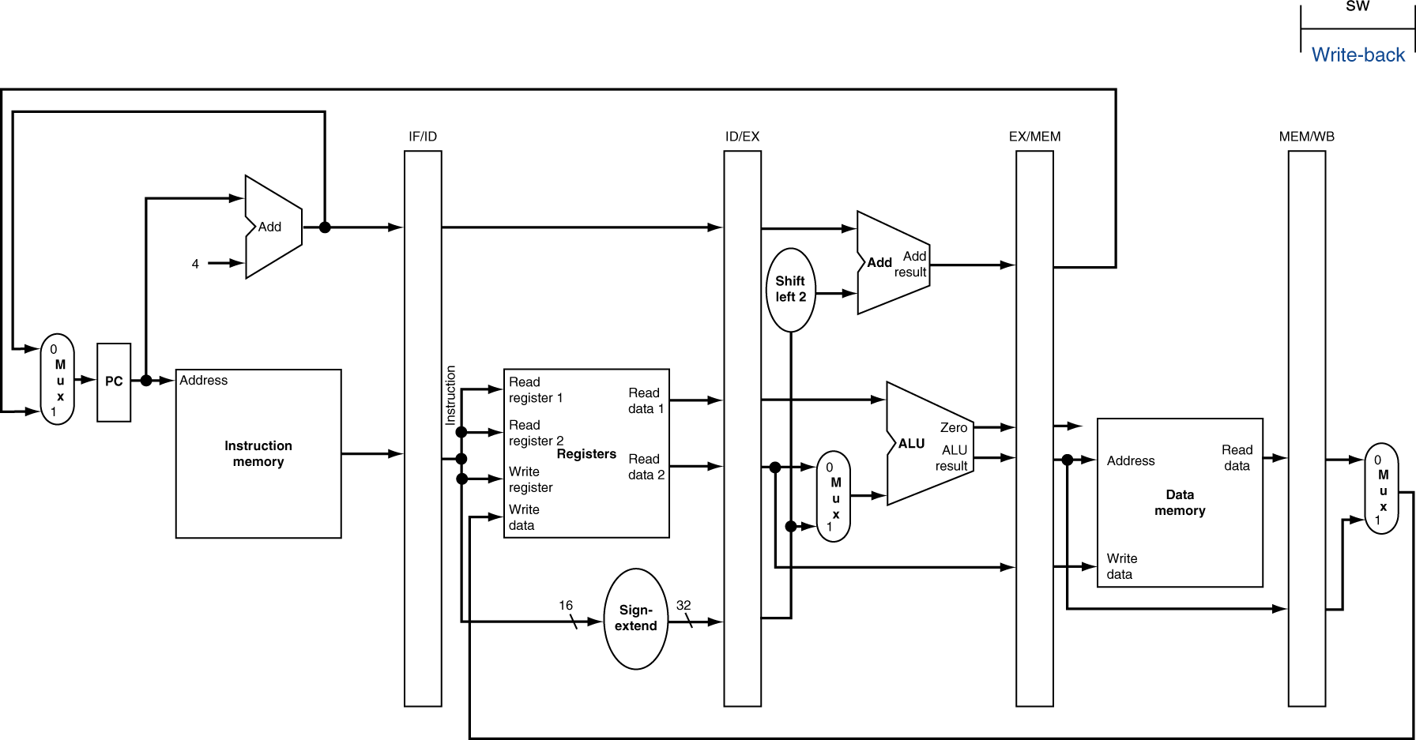
WB for Store
Chapter 4 — The Processor — <number>
Notes:
Morgan Kaufmann Publishers
Chapter 4 — The Processor

Slide 14
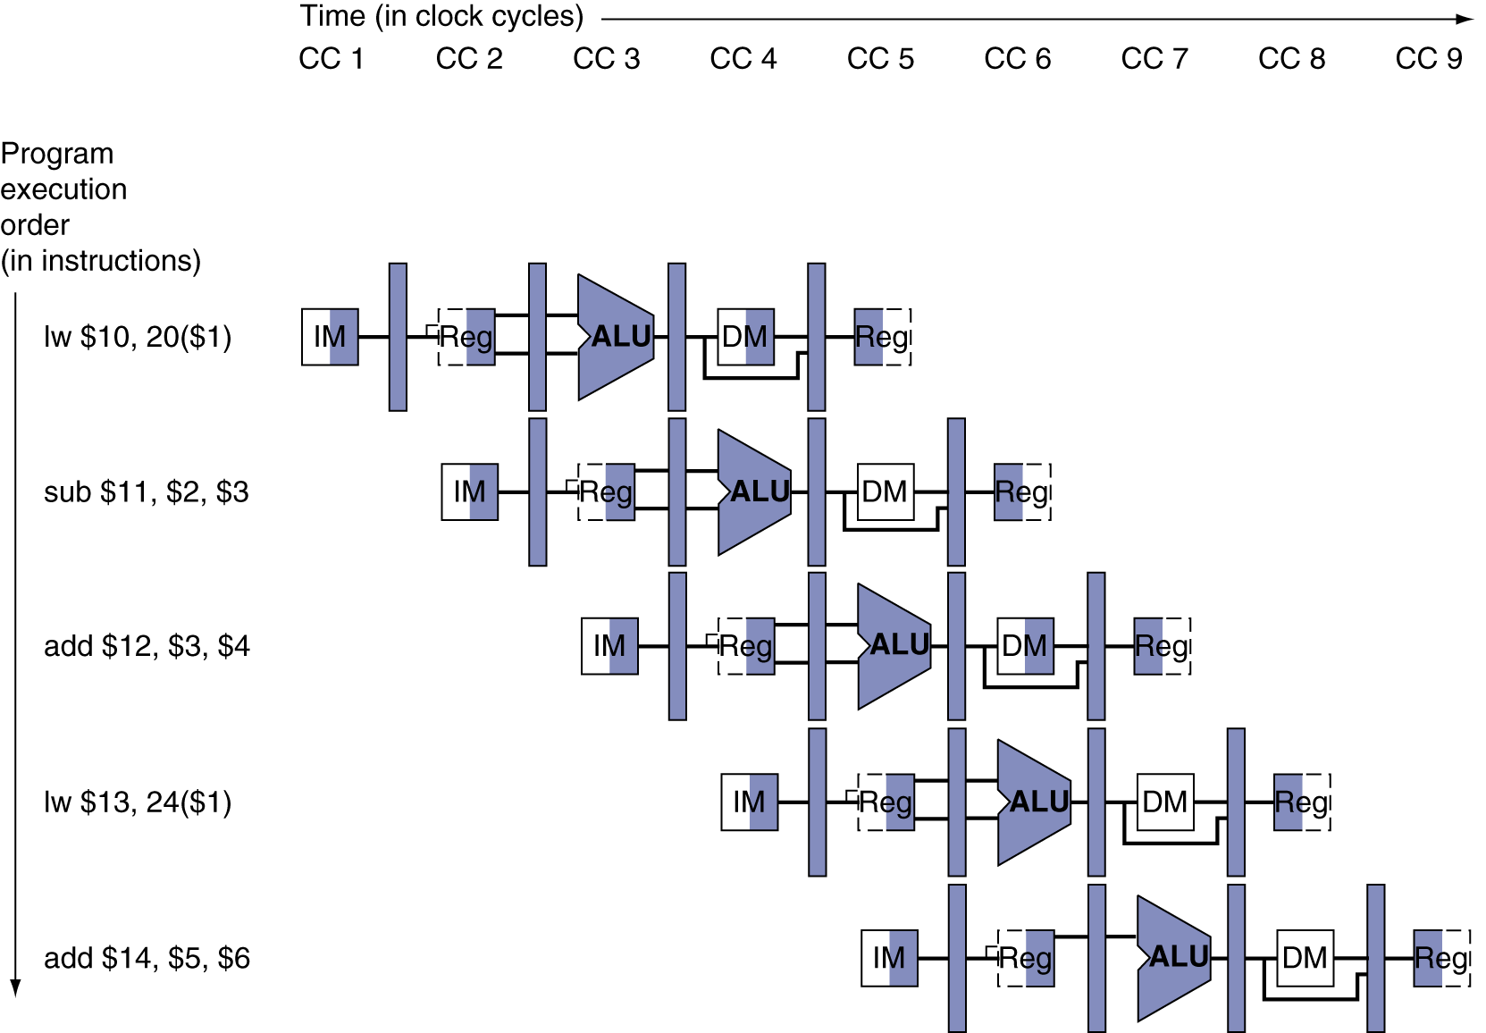
Multi-Cycle Pipeline Diagram
Form showing resource usage
Chapter 4 — The Processor — <number>
Notes:
Morgan Kaufmann Publishers
Chapter 4 — The Processor

Slide 15
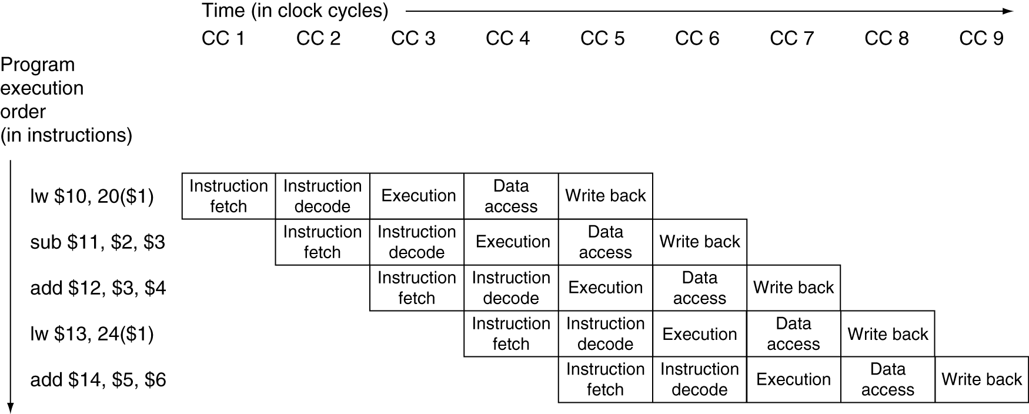
Multi-Cycle Pipeline Diagram
Traditional form
Chapter 4 — The Processor — <number>
Notes:
Morgan Kaufmann Publishers
Chapter 4 — The Processor

Slide 16
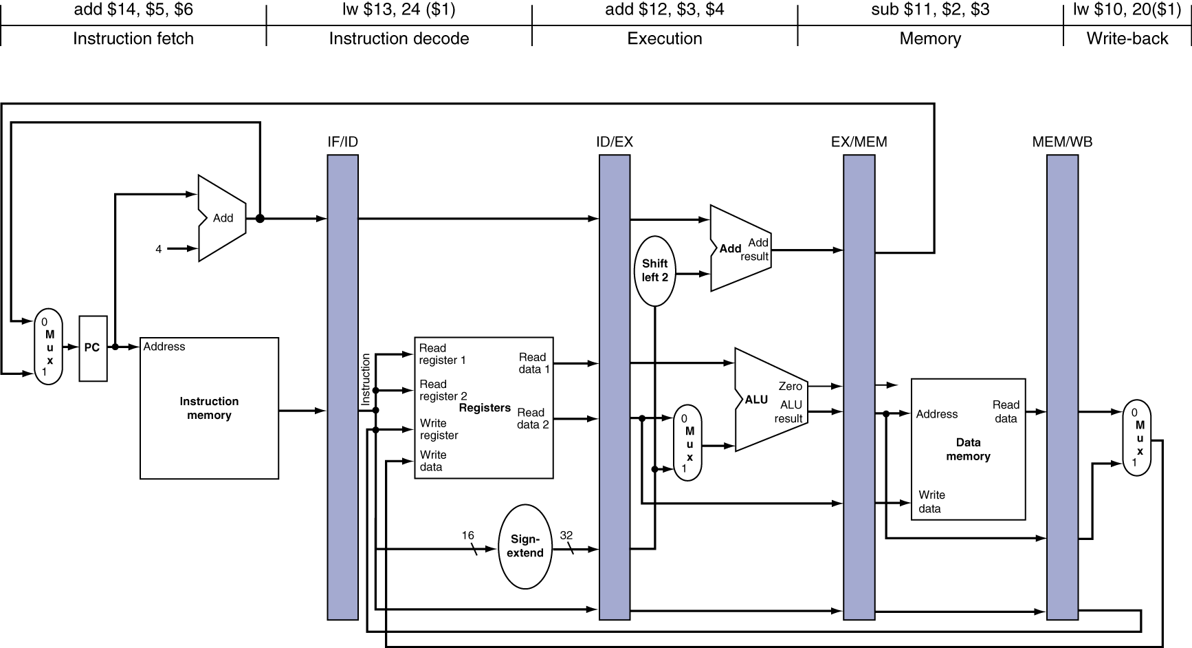
Single-Cycle Pipeline Diagram
State of pipeline in a given cycle
Chapter 4 — The Processor — <number>
Notes:
Morgan Kaufmann Publishers
Chapter 4 — The Processor

Slide 17
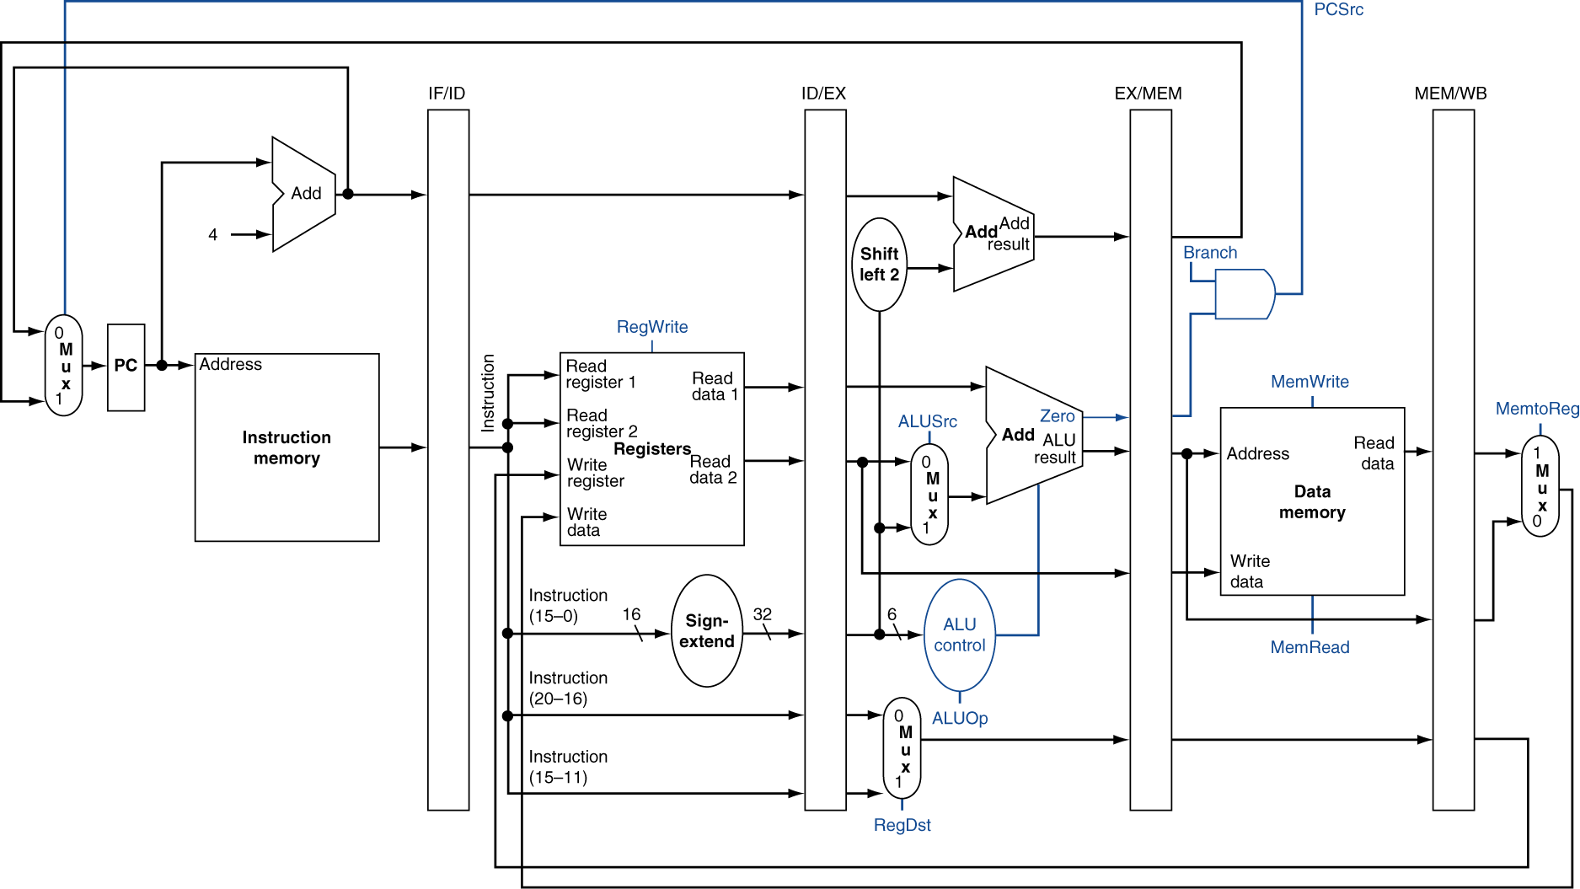
Pipelined Control (Simplified)
Chapter 4 — The Processor — <number>
Notes:
Morgan Kaufmann Publishers
Chapter 4 — The Processor

Slide 18
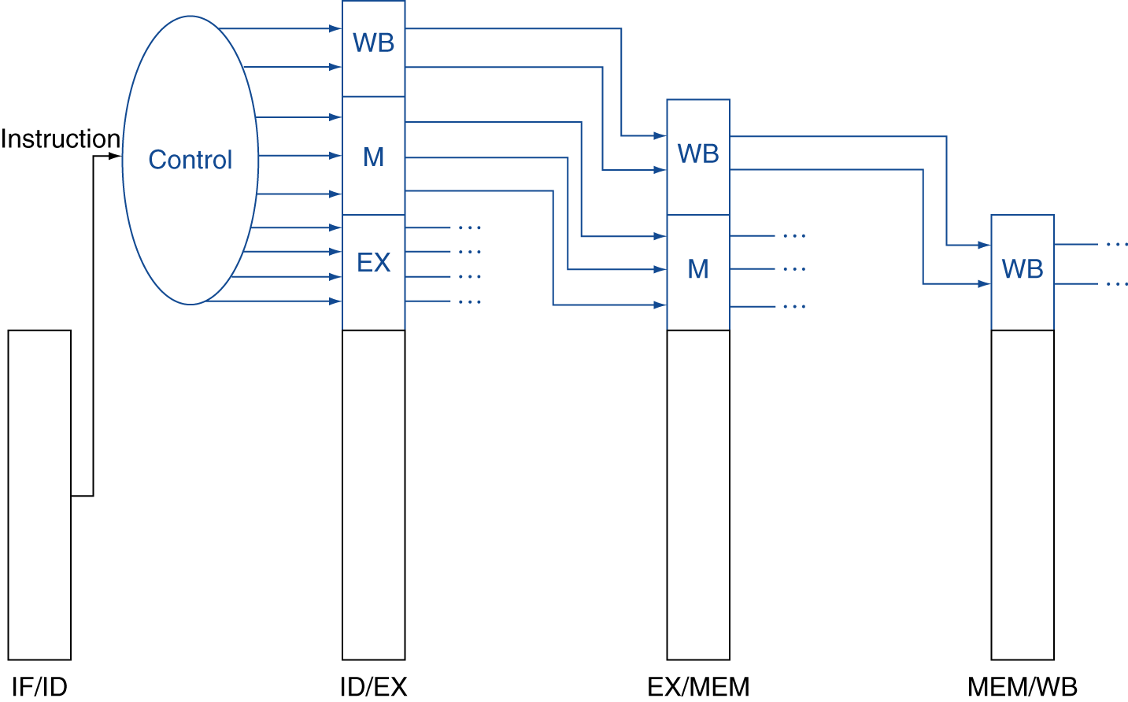
Pipelined Control
Control signals derived from instruction
  As in single-cycle implementation
Chapter 4 — The Processor — <number>
Notes:
Morgan Kaufmann Publishers
Chapter 4 — The Processor

Slide 19
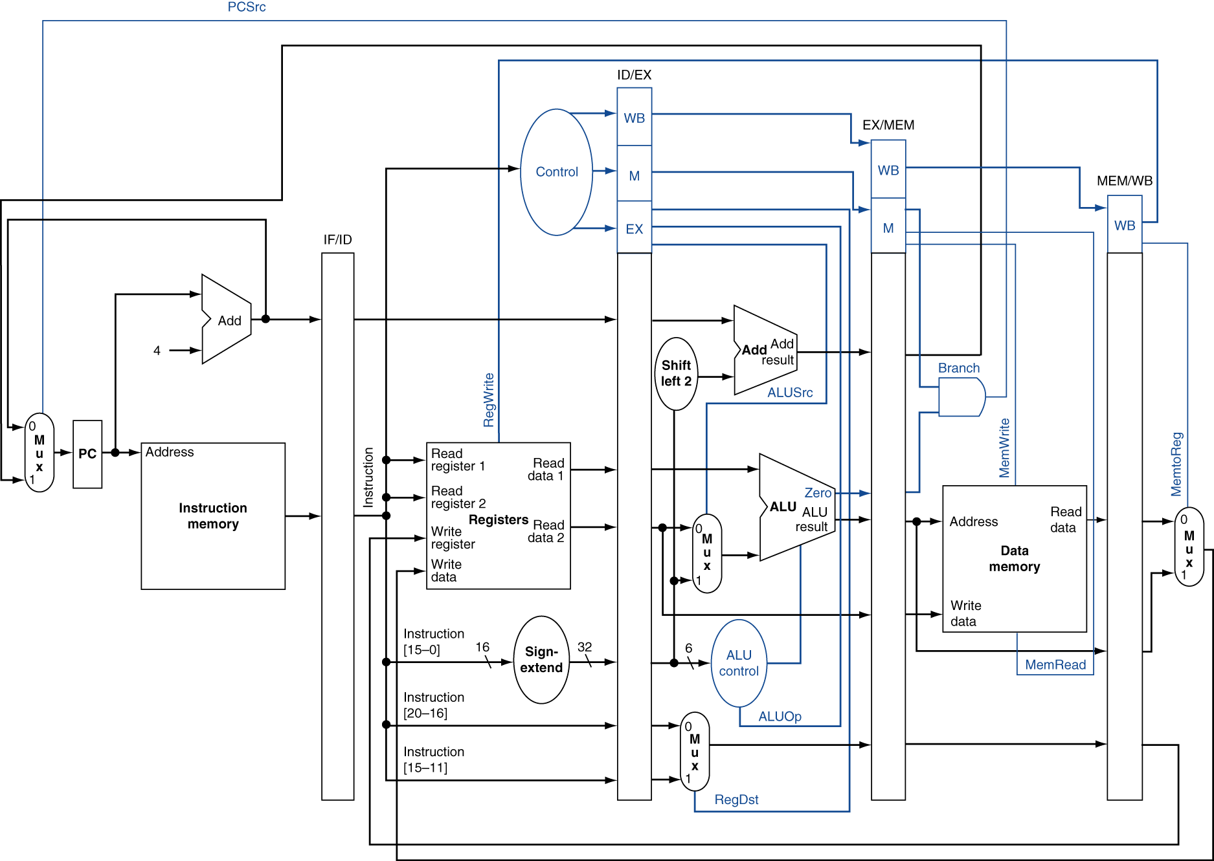
Pipelined Control
Chapter 4 — The Processor — <number>
Notes:
Morgan Kaufmann Publishers
Chapter 4 — The Processor

Slide 20
Data Hazards in ALU Instructions
Consider this sequence:
  sub $2, $1,$3
  and $12,$2,$5
  or $13,$6,$2
  add $14,$2,$2
  sw $15,100($2)
We can resolve hazards with forwarding
  How do we detect when to forward?
§4.7 Data Hazards: Forwarding vs. Stalling
Chapter 4 — The Processor — <number>
Notes:
Morgan Kaufmann Publishers
Chapter 4 — The Processor

Slide 21
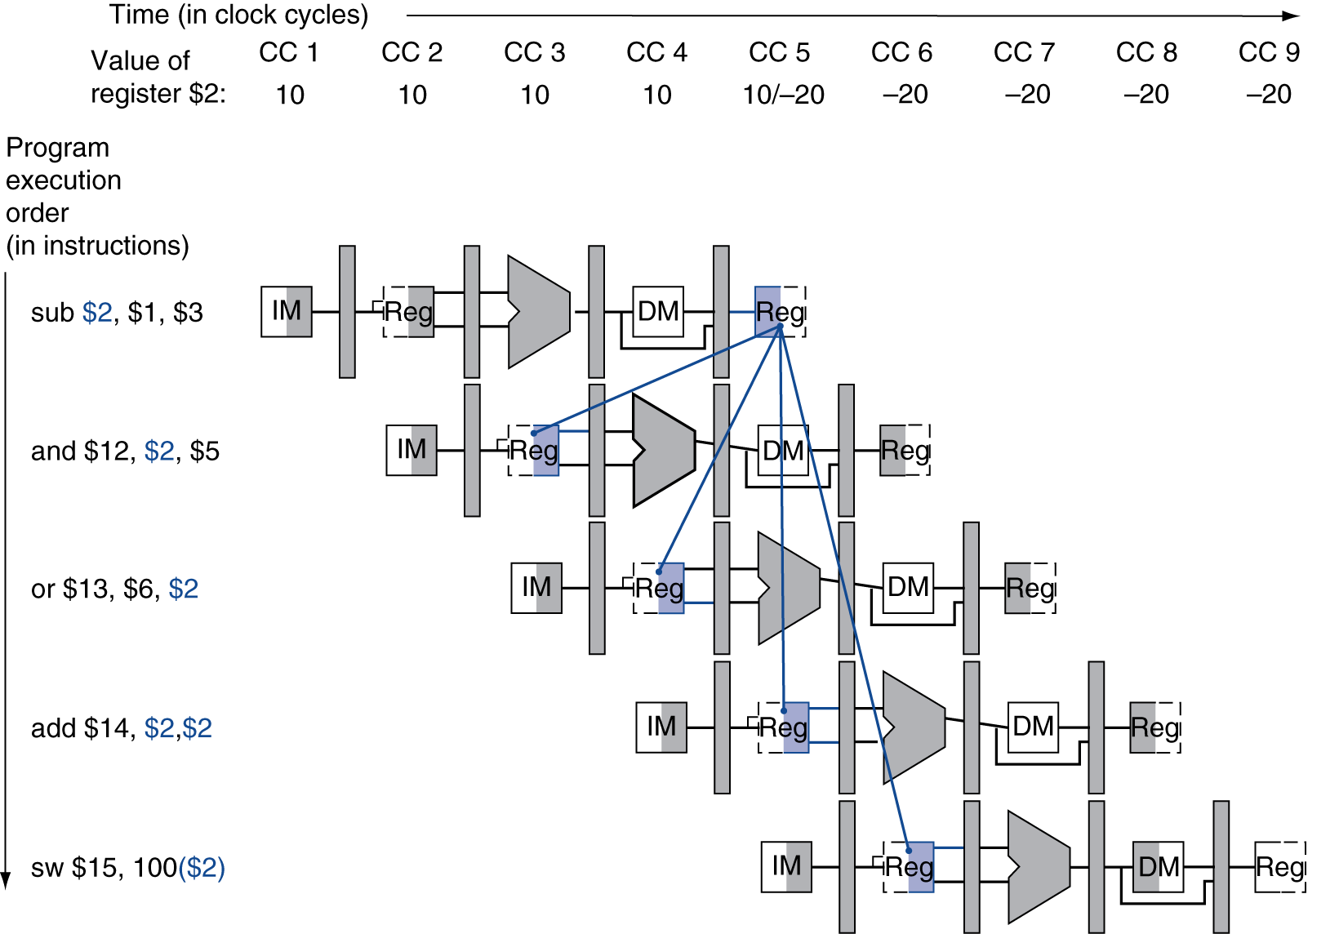
Dependencies & Forwarding
Chapter 4 — The Processor — <number>
Notes:
Morgan Kaufmann Publishers
Chapter 4 — The Processor

Slide 22
Detecting the Need to Forward
Pass register numbers along pipeline
  e.g., ID/EX.RegisterRs = register number for Rs sitting in ID/EX pipeline register
ALU operand register numbers in EX stage are given by
  ID/EX.RegisterRs, ID/EX.RegisterRt
Data hazards when
  1a. EX/MEM.RegisterRd = ID/EX.RegisterRs
  1b. EX/MEM.RegisterRd = ID/EX.RegisterRt
  2a. MEM/WB.RegisterRd = ID/EX.RegisterRs
  2b. MEM/WB.RegisterRd = ID/EX.RegisterRt
Fwd from
EX/MEM
pipeline reg
Fwd from
MEM/WB
pipeline reg
Chapter 4 — The Processor — <number>
Notes:
Morgan Kaufmann Publishers
Chapter 4 — The Processor

Slide 23
Detecting the Need to Forward
But only if forwarding instruction will write to a register!
  EX/MEM.RegWrite, MEM/WB.RegWrite
And only if Rd for that instruction is not $zero
  EX/MEM.RegisterRd ≠ 0,
  MEM/WB.RegisterRd ≠ 0
Chapter 4 — The Processor — <number>
Notes:
Morgan Kaufmann Publishers
Chapter 4 — The Processor

Slide 24
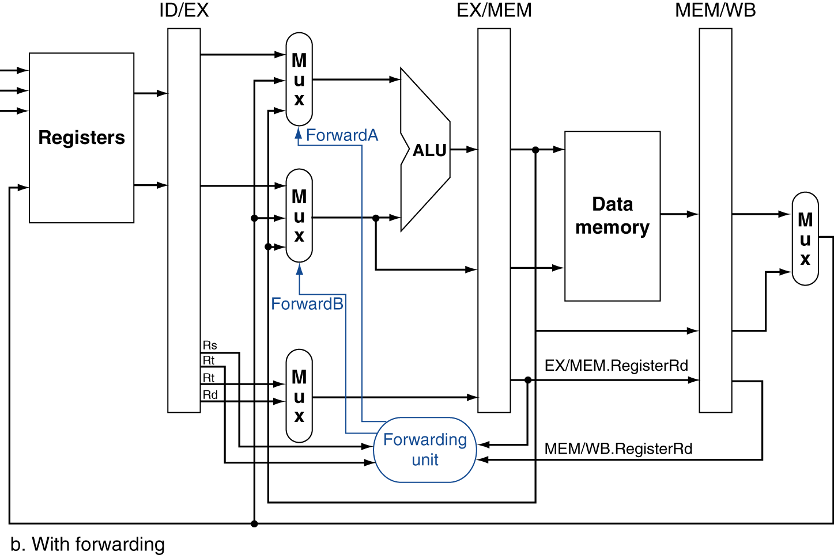
Forwarding Paths
Chapter 4 — The Processor — <number>
Notes:
Morgan Kaufmann Publishers
Chapter 4 — The Processor

Slide 25
Forwarding Conditions
EX hazard
  if (EX/MEM.RegWrite and (EX/MEM.RegisterRd ≠ 0)
  and (EX/MEM.RegisterRd = ID/EX.RegisterRs))
  ForwardA = 10
  if (EX/MEM.RegWrite and (EX/MEM.RegisterRd ≠ 0)
  and (EX/MEM.RegisterRd = ID/EX.RegisterRt))
  ForwardB = 10
MEM hazard
  if (MEM/WB.RegWrite and (MEM/WB.RegisterRd ≠ 0)
  and (MEM/WB.RegisterRd = ID/EX.RegisterRs))
  ForwardA = 01
  if (MEM/WB.RegWrite and (MEM/WB.RegisterRd ≠ 0)
  and (MEM/WB.RegisterRd = ID/EX.RegisterRt))
  ForwardB = 01
Chapter 4 — The Processor — <number>
Notes:
Morgan Kaufmann Publishers
Chapter 4 — The Processor

Slide 26
Double Data Hazard
Consider the sequence:
  add $1,$1,$2
  add $1,$1,$3
  add $1,$1,$4
Both hazards occur
  Want to use the most recent
Revise MEM hazard condition
  Only fwd if EX hazard condition isn’t true
Chapter 4 — The Processor — <number>
Notes:
Morgan Kaufmann Publishers
Chapter 4 — The Processor

Slide 27
Revised Forwarding Condition
MEM hazard
  if (MEM/WB.RegWrite and (MEM/WB.RegisterRd ≠ 0)
  and not (EX/MEM.RegWrite and (EX/MEM.RegisterRd ≠ 0)
  and (EX/MEM.RegisterRd = ID/EX.RegisterRs))
  and (MEM/WB.RegisterRd = ID/EX.RegisterRs))
  ForwardA = 01
  if (MEM/WB.RegWrite and (MEM/WB.RegisterRd ≠ 0)
  and not (EX/MEM.RegWrite and (EX/MEM.RegisterRd ≠ 0)
  and (EX/MEM.RegisterRd = ID/EX.RegisterRt))
  and (MEM/WB.RegisterRd = ID/EX.RegisterRt))
  ForwardB = 01
Chapter 4 — The Processor — <number>
Notes:
Morgan Kaufmann Publishers
Chapter 4 — The Processor

Slide 28
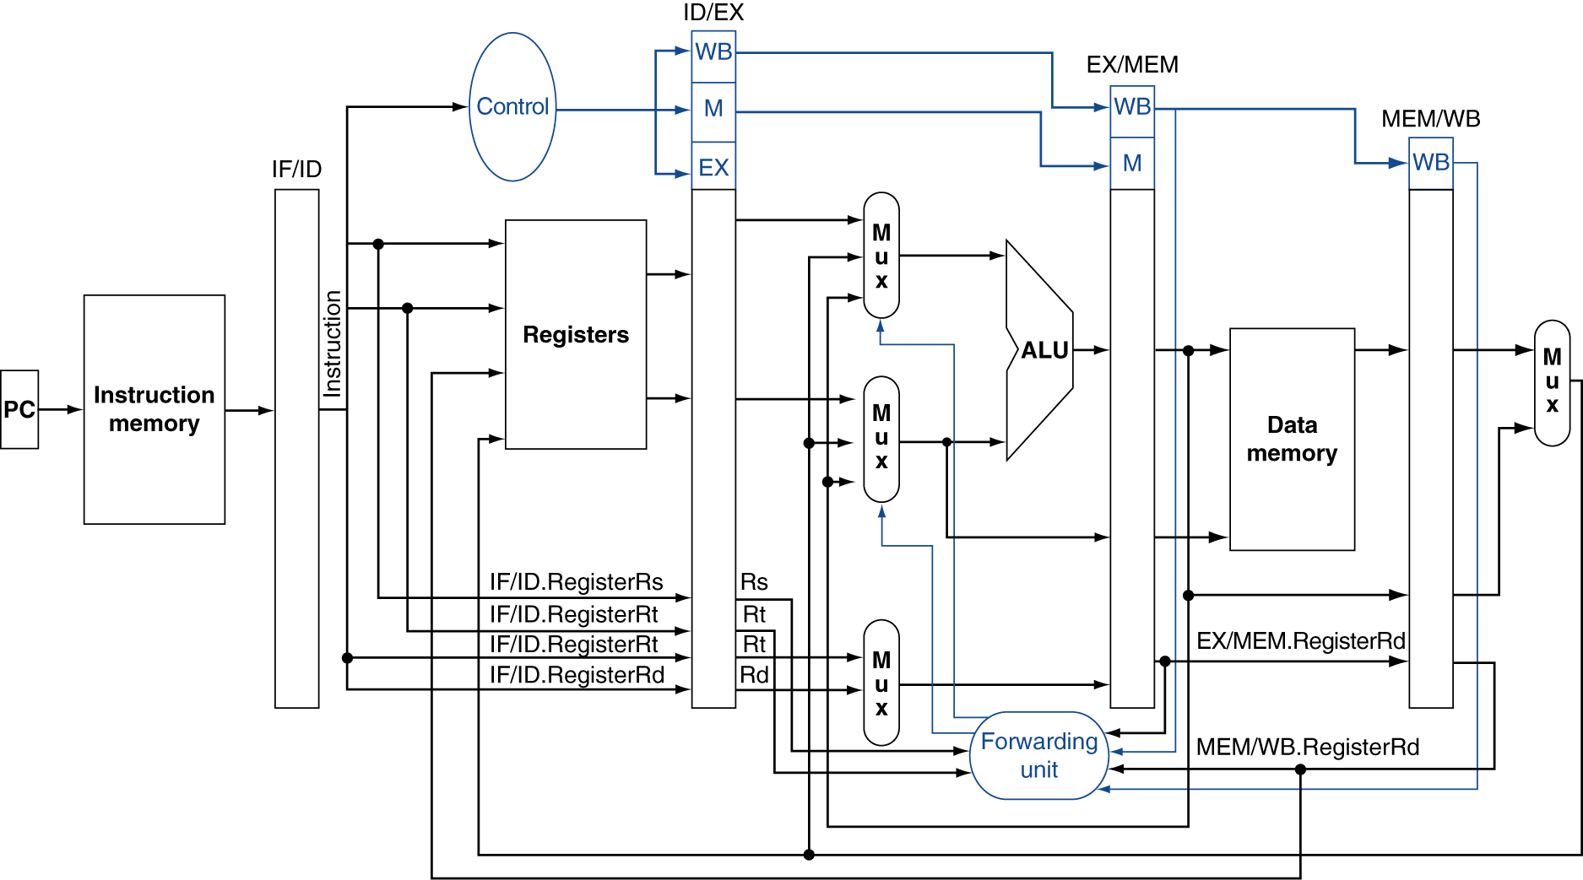
Datapath with Forwarding
Chapter 4 — The Processor — <number>
Notes:
Morgan Kaufmann Publishers
Chapter 4 — The Processor

Slide 29
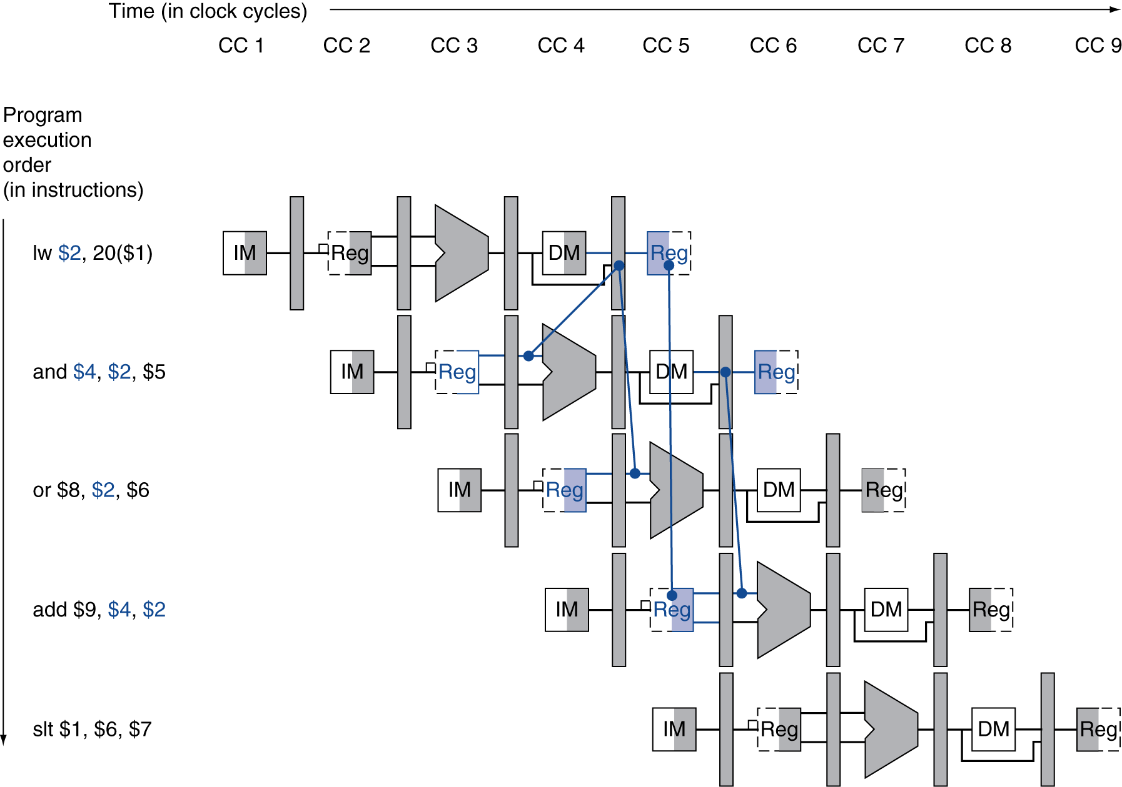
Load-Use Data Hazard
Need to stall for one cycle
Chapter 4 — The Processor — <number>
Notes:
Morgan Kaufmann Publishers
Chapter 4 — The Processor

Slide 30
Load-Use Hazard Detection
Check when using instruction is decoded in ID stage
ALU operand register numbers in ID stage are given by
  IF/ID.RegisterRs, IF/ID.RegisterRt
Load-use hazard when
  ID/EX.MemRead and
  ((ID/EX.RegisterRt = IF/ID.RegisterRs) or
  (ID/EX.RegisterRt = IF/ID.RegisterRt))
If detected, stall and insert bubble
Chapter 4 — The Processor — <number>
Notes:
Morgan Kaufmann Publishers
Chapter 4 — The Processor

Slide 31
How to Stall the Pipeline
Force control values in ID/EX register
to 0
  EX, MEM and WB do nop (no-operation)
Prevent update of PC and IF/ID register
  Using instruction is decoded again
  Following instruction is fetched again
  1-cycle stall allows MEM to read data for lw
    Can subsequently forward to EX stage
Chapter 4 — The Processor — <number>
Notes:
Morgan Kaufmann Publishers
Chapter 4 — The Processor

Slide 32
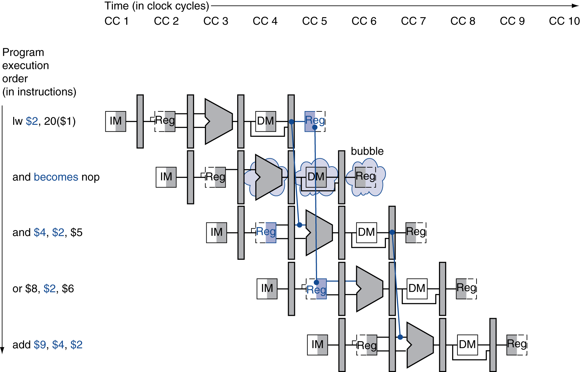
Stall/Bubble in the Pipeline
Stall inserted here
Chapter 4 — The Processor — <number>
Notes:
Morgan Kaufmann Publishers
Chapter 4 — The Processor

Slide 33
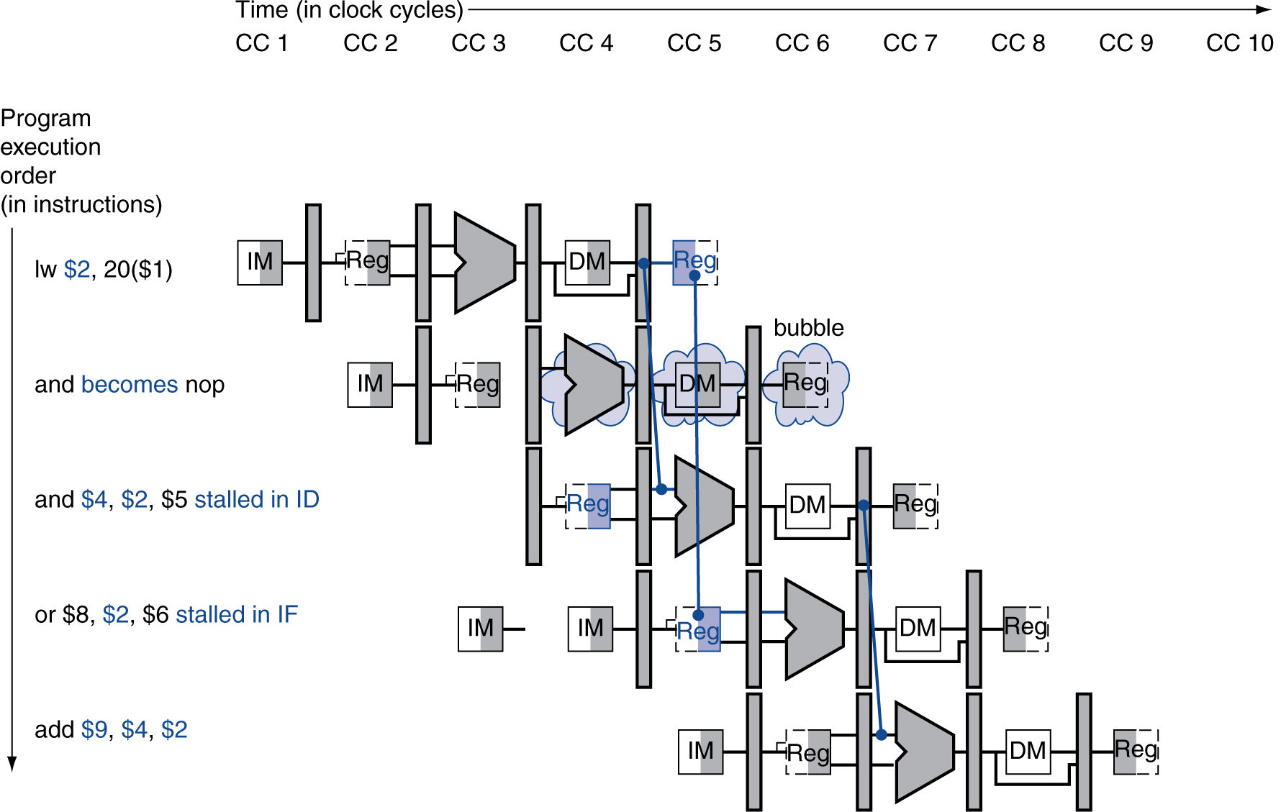
Stall/Bubble in the Pipeline
Or, more accurately…
Chapter 4 — The Processor — <number>
Notes:
Morgan Kaufmann Publishers
Chapter 4 — The Processor

Slide 34
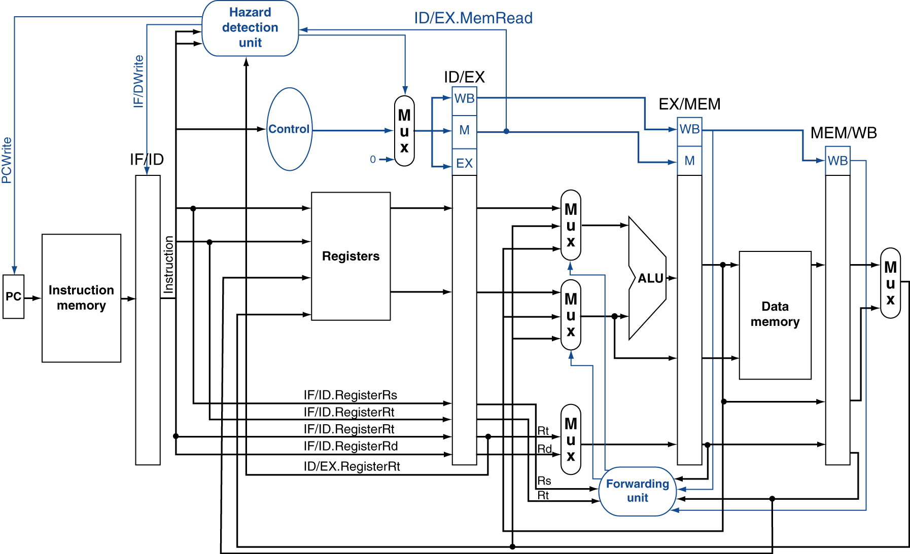
Datapath with Hazard Detection
Chapter 4 — The Processor — <number>
Notes:
Morgan Kaufmann Publishers
Chapter 4 — The Processor

Slide 35
Stalls and Performance
The BIG Picture
Stalls reduce performance
  But are required to get correct results
Compiler can arrange code to avoid hazards and stalls
  Requires knowledge of the pipeline structure
Chapter 4 — The Processor — <number>
Notes:
Morgan Kaufmann Publishers
Chapter 4 — The Processor

Slide 36
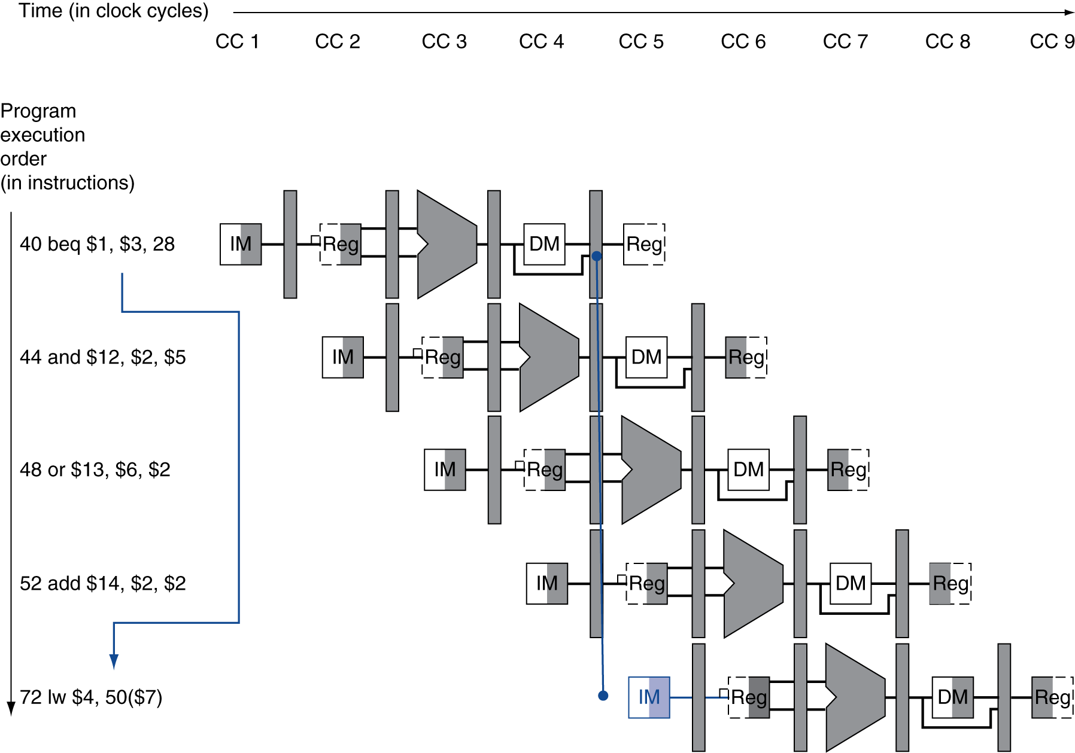
Branch Hazards
§4.8 Control Hazards
If branch outcome determined in MEM
Flush these
instructions
(Set control
values to 0)
PC
Chapter 4 — The Processor — <number>
Notes:
Morgan Kaufmann Publishers
Chapter 4 — The Processor

Slide 37
Reducing Branch Delay
Move hardware to determine outcome to ID stage
  Target address adder
  Register comparator
Example: branch taken
  36: sub $10, $4, $8
  40: beq $1, $3, 7
  44: and $12, $2, $5
  48: or $13, $2, $6
  52: add $14, $4, $2
  56: slt $15, $6, $7
  ...
  72: lw $4, 50($7)
Chapter 4 — The Processor — <number>
Notes:
Morgan Kaufmann Publishers
Chapter 4 — The Processor

Slide 38
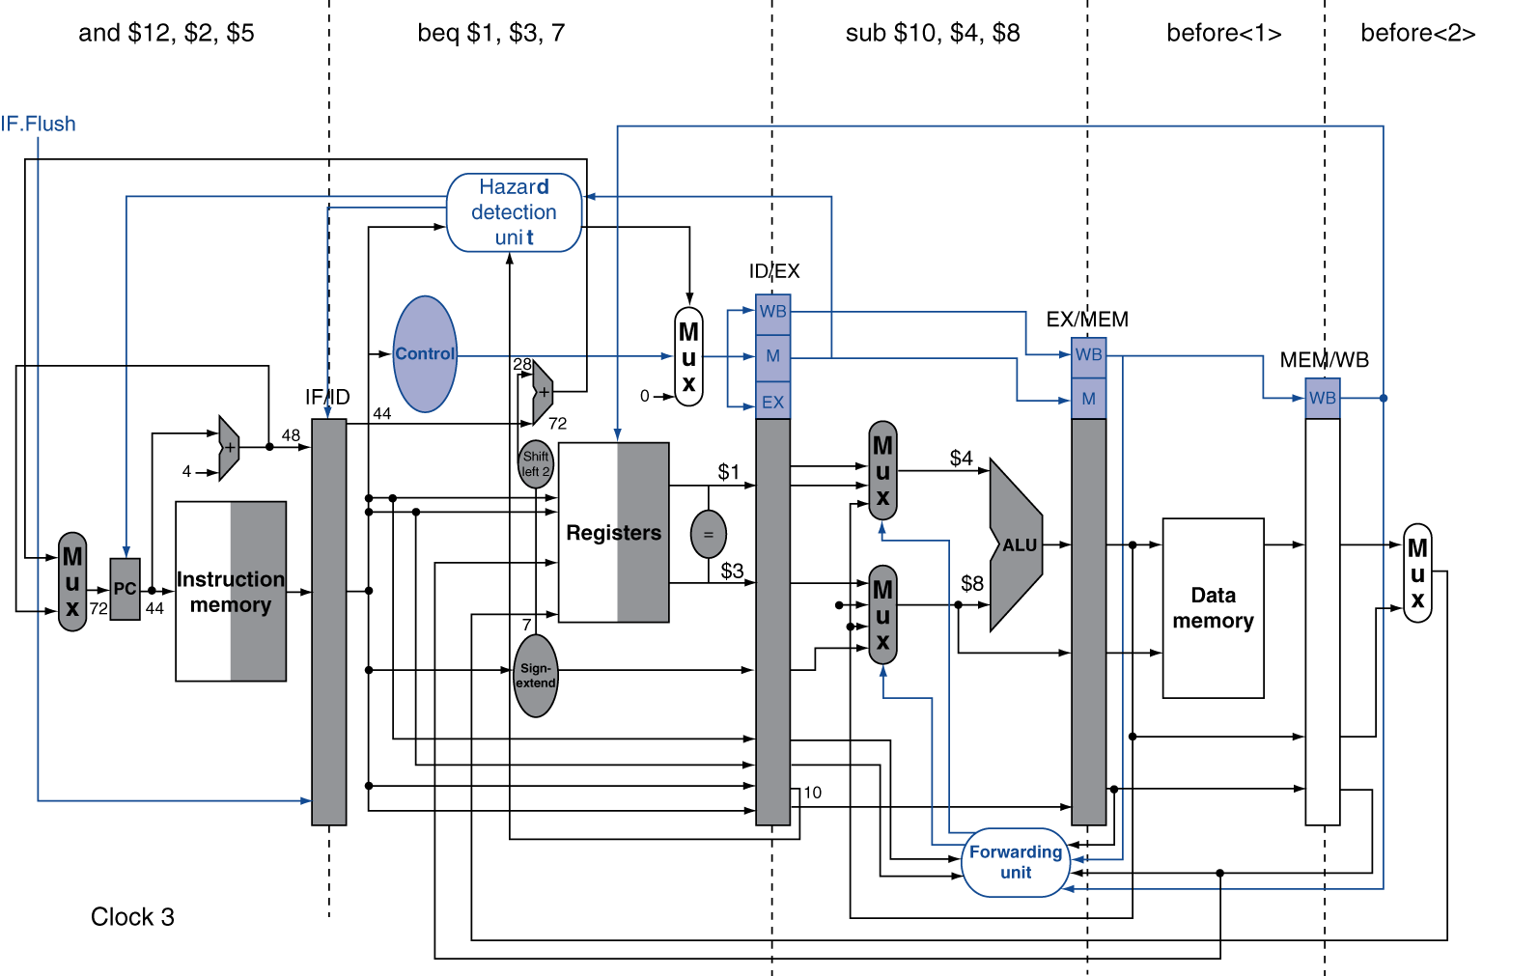
Example: Branch Taken
Chapter 4 — The Processor — <number>
Notes:
Morgan Kaufmann Publishers
Chapter 4 — The Processor

Slide 39
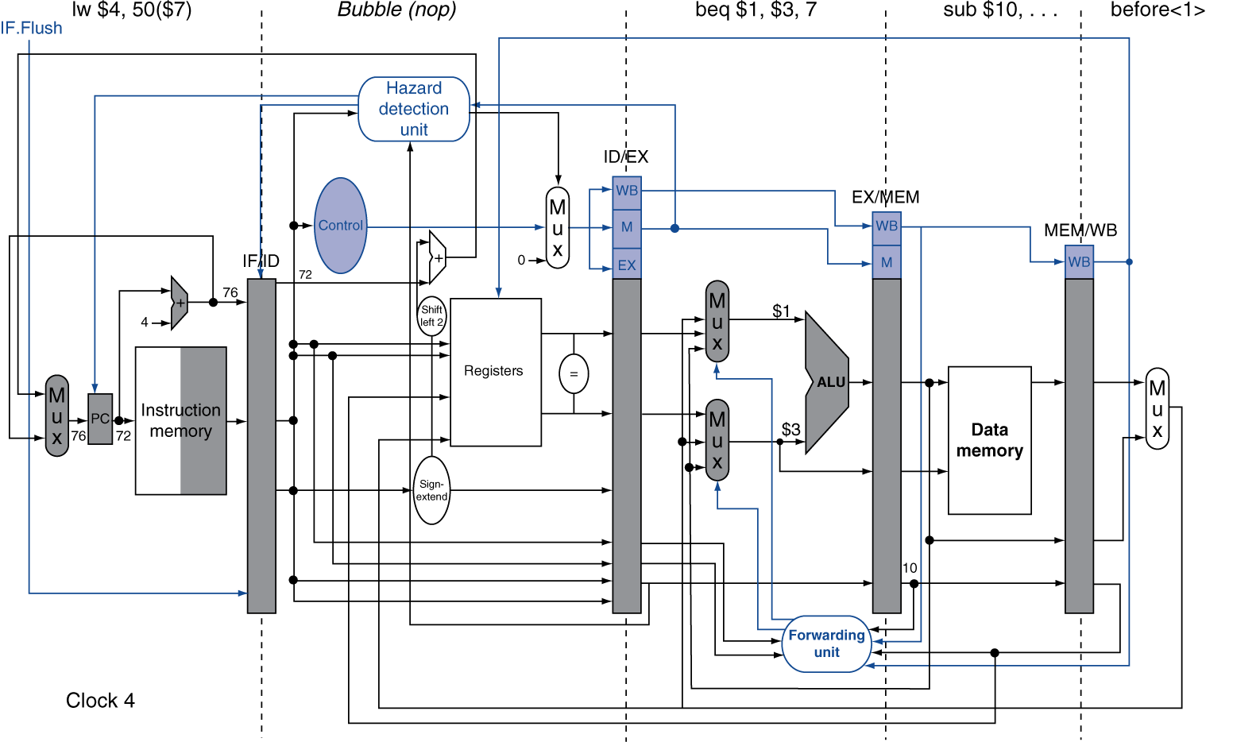
Example: Branch Taken
Chapter 4 — The Processor — <number>
Notes:
Morgan Kaufmann Publishers
Chapter 4 — The Processor

Slide 40
Data Hazards for Branches
If a comparison register is a destination of 2nd or 3rd preceding ALU instruction
add $1, $2, $3
IF
ID
EX
MEM
WB
add $4, $5, $6
IF
ID
EX
MEM
WB
…
IF
ID
EX
MEM
WB
beq $1, $4, target
IF
ID
EX
MEM
WB
Can resolve using forwarding
Chapter 4 — The Processor — <number>
Notes:
Morgan Kaufmann Publishers
Chapter 4 — The Processor

Slide 41
Data Hazards for Branches
If a comparison register is a destination of preceding ALU instruction or 2nd preceding load instruction
  Need 1 stall cycle
lw $1, addr
IF
ID
EX
MEM
WB
add $4, $5, $6
IF
ID
EX
MEM
WB
beq stalled
IF
ID
beq $1, $4, target
ID
EX
MEM
WB
Chapter 4 — The Processor — <number>
Notes:
Morgan Kaufmann Publishers
Chapter 4 — The Processor

Slide 42
Data Hazards for Branches
If a comparison register is a destination of immediately preceding load instruction
  Need 2 stall cycles
lw $1, addr
IF
ID
EX
MEM
WB
beq stalled
IF
ID
beq stalled
ID
beq $1, $0, target
ID
EX
MEM
WB
Chapter 4 — The Processor — <number>
Notes:
Morgan Kaufmann Publishers
Chapter 4 — The Processor

Slide 43
Dynamic Branch Prediction
In deeper and superscalar pipelines, branch penalty is more significant
Use dynamic prediction
  Branch prediction buffer (aka branch history table)
  Indexed by recent branch instruction addresses
  Stores outcome (taken/not taken)
  To execute a branch
    Check table, expect the same outcome
    Start fetching from fall-through or target
    If wrong, flush pipeline and flip prediction
Chapter 4 — The Processor — <number>
Notes:
Morgan Kaufmann Publishers
Chapter 4 — The Processor

Slide 44
1-Bit Predictor: Shortcoming
Inner loop branches mispredicted twice!
outer: …
…
inner: …
…
beq …, …, inner
…
beq …, …, outer
  Mispredict as taken on last iteration of inner loop
  Then mispredict as not taken on first iteration of inner loop next time around
Chapter 4 — The Processor — <number>
Notes:
Morgan Kaufmann Publishers
Chapter 4 — The Processor

Slide 45
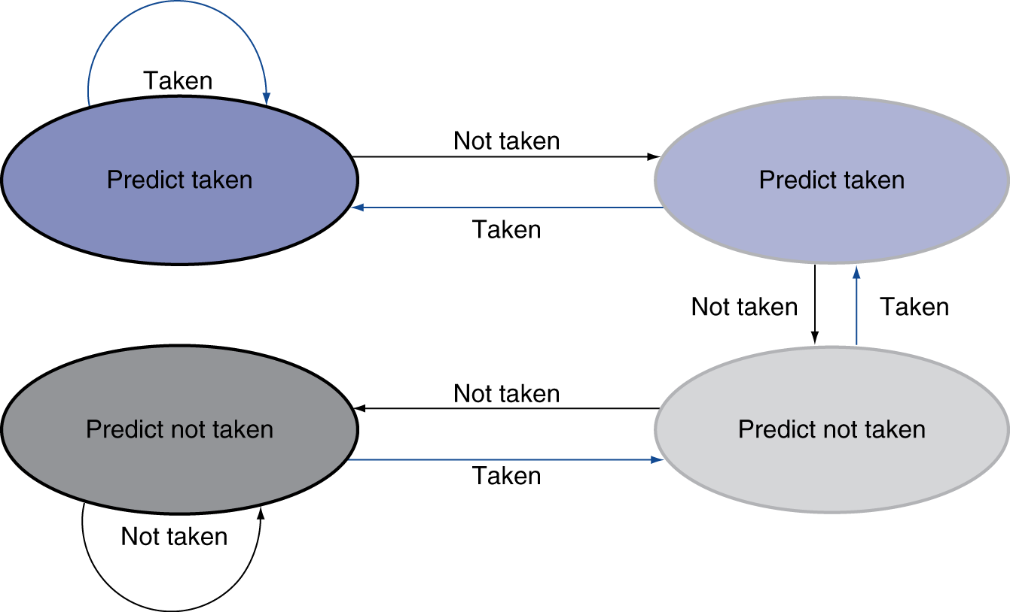
2-Bit Predictor
Only change prediction on two successive mispredictions
Chapter 4 — The Processor — <number>
Notes:
Morgan Kaufmann Publishers
Chapter 4 — The Processor

Slide 46
Calculating the Branch Target
Even with predictor, still need to calculate the target address
  1-cycle penalty for a taken branch
Branch target buffer
  Cache of target addresses
  Indexed by PC when instruction fetched
    If hit and instruction is branch predicted taken, can fetch target immediately
Chapter 4 — The Processor — <number>
Notes:
Morgan Kaufmann Publishers
Chapter 4 — The Processor

